Slide 1

Faculty 2: Computer Science and Engineering
Master of Science in High Integrity Systems
A Comparison of two clustering methods
(K-mean and Fuzzy clustering) for COVID-19 data
Submitted By
Tonmoy Deb Chowdhury
Matriculation Number: 1340439
Supervisor:
Prof. Dr. Christina Andersson
Co-Supervisor:
Prof. Dr. Doina Logofatu

Slide 2
Contents
Introduction
Literature Review and Findings
Research Gap
Methodology
Data Collection and Preprocessing
Feature Selection
Clustering (K mean and Fuzzy)
Conclusion

Slide 3
Introduction
Background
Importance of Clustering on COVID-19 Data
Aims of this study

Slide 4
Literature Review and Findings
Purpose :
Understanding past research of clustering techniques for COVID-19 Dataset.
Key Data Sources:
WHO, Our World in Data, Centers for Disease Control and Prevention, Johns Hopkins University
Important Findings:
K-means and hierarchical clustering are popular for speed.
Fuzzy allows details and flexible analysis

Slide 5
Research Gap
Absence of Comparative studies
Normalization, outlier removal - impact on clustering performance

Slide 6
Methodology
Data Collection
Data Preprocessing
Cleaning
Imputation
Feature Selection
Clustering Application:
K- Mean
Fuzzy

Slide 7
Data Collection and Preprocessing
Step 1: Collecting Data (Source: Our World in Data)
Step 2: Missing Values
Step 3: Filtering Data
Step 4: Preliminary COVID-19 Data Analysis

Slide 8
Data Collection and Preprocessing – Preliminary analysis
The Dataset Contains 358,646 entries with 67 variables.
The dataset contains several data points related to COVID-19 for example new cases, new deaths, vaccinations, location , date and so on.
255 unique countries
Range of date 1st January 2020 to 22nd November 2022

Slide 9
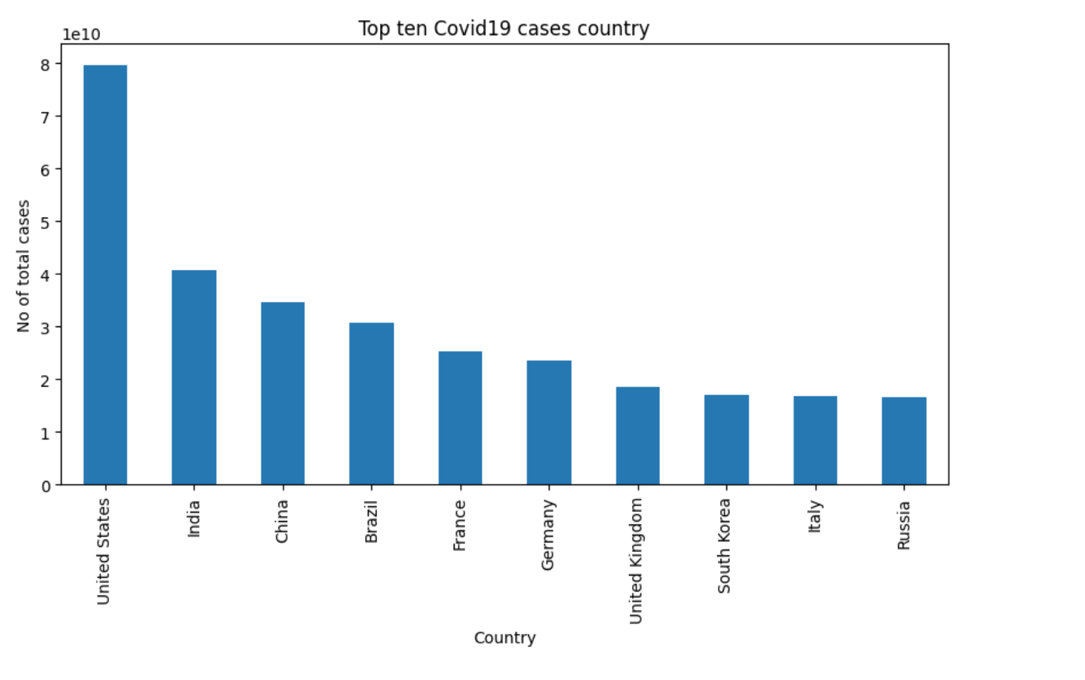
Data Collection and Preprocessing – Preliminary analysis
United States
India
China
Brazil
France
Germany
United Kingdom
South Korea
Italy
Russia
Top Ten countries based on COVID-19 cases

Slide 10
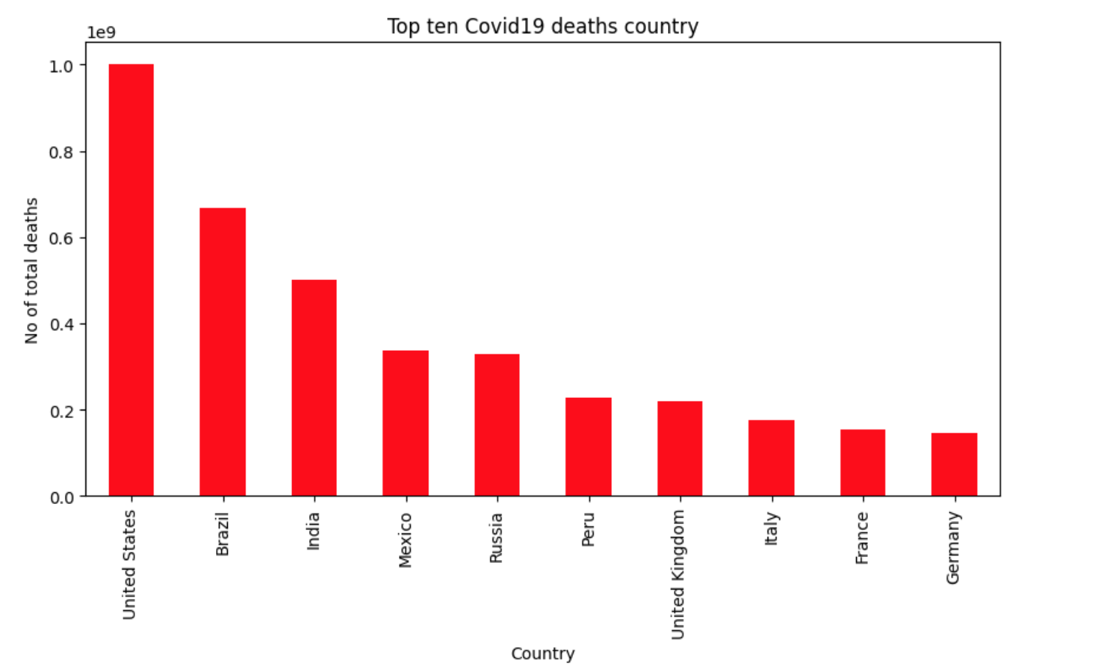
Data Collection and Preprocessing – Preliminary analysis
United States
Brazil
India
Mexico
Russia
Peru
United Kingdom
Italy
France
Germany
Top Ten countries based on COVID-19 death

Slide 11
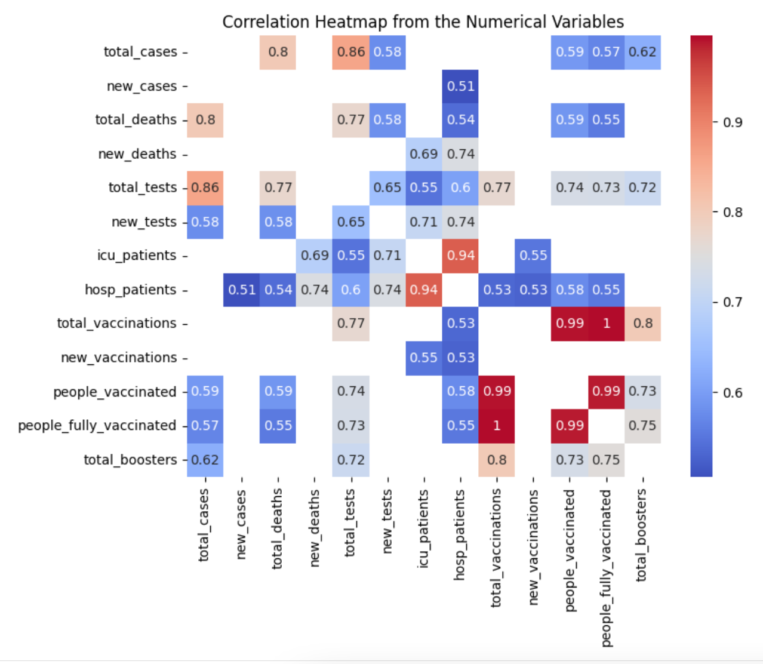
Feature Selection
Adopted: New_cases,
new_deaths,
new_vaccinations
Excluded: Total_cases,
Total_deaths,
People_fully_vaccinated –cumulative metrics
Hosp_patients, icu_patients – missing values

Slide 12
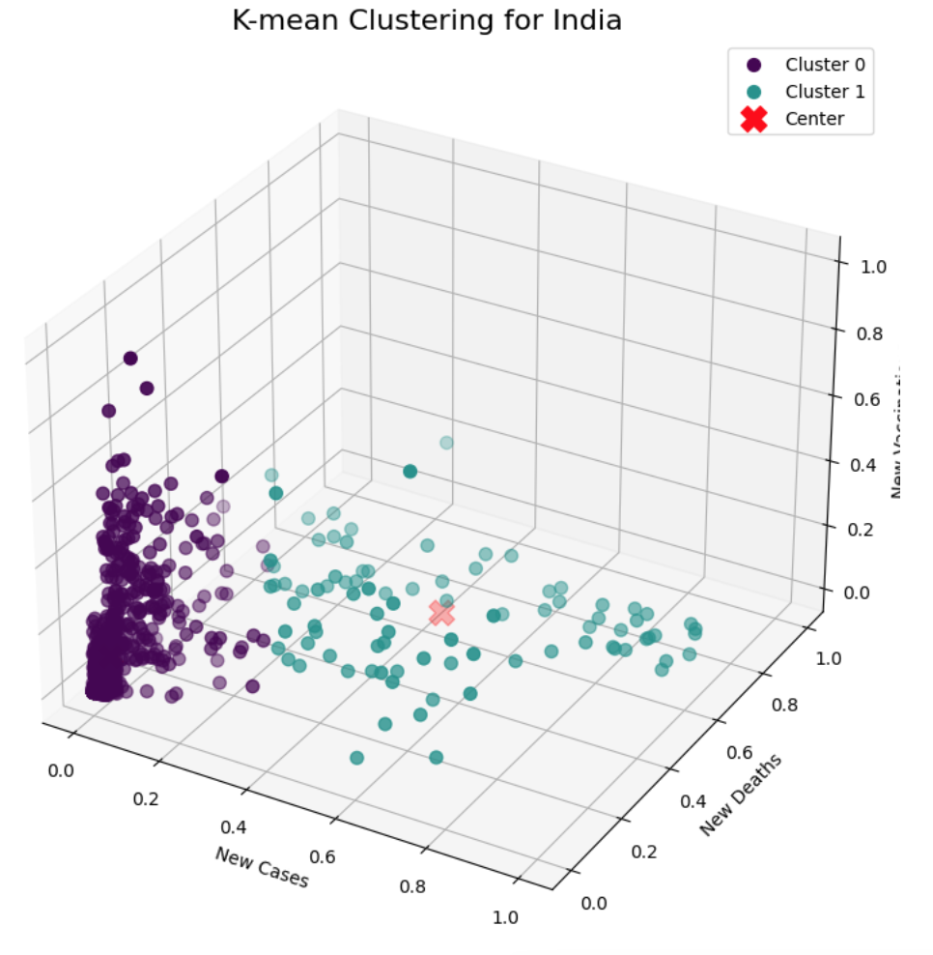
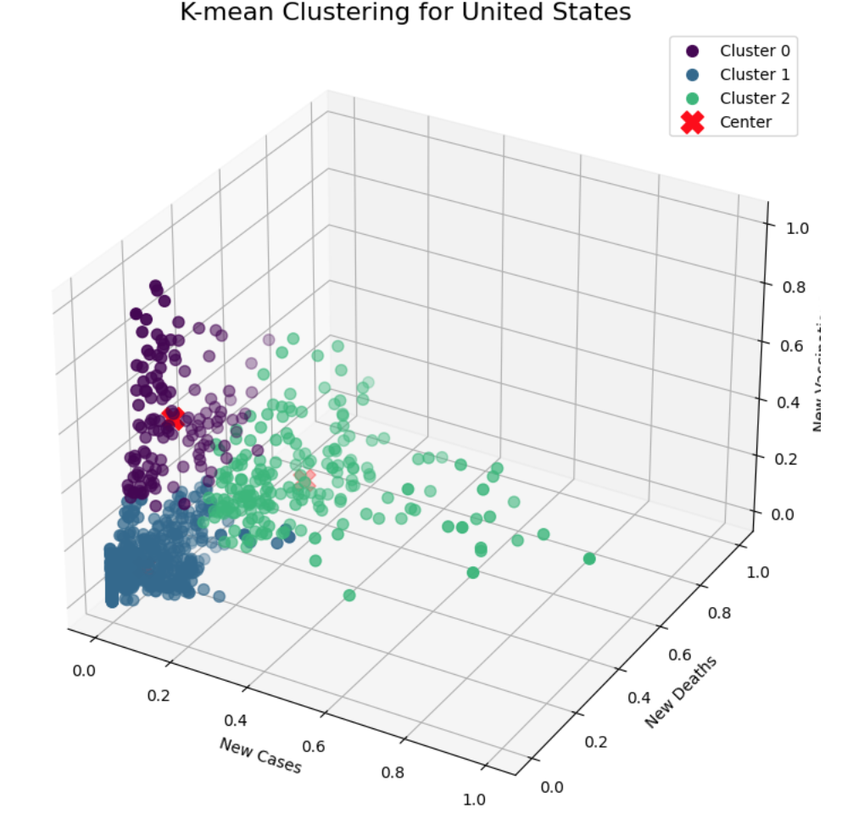
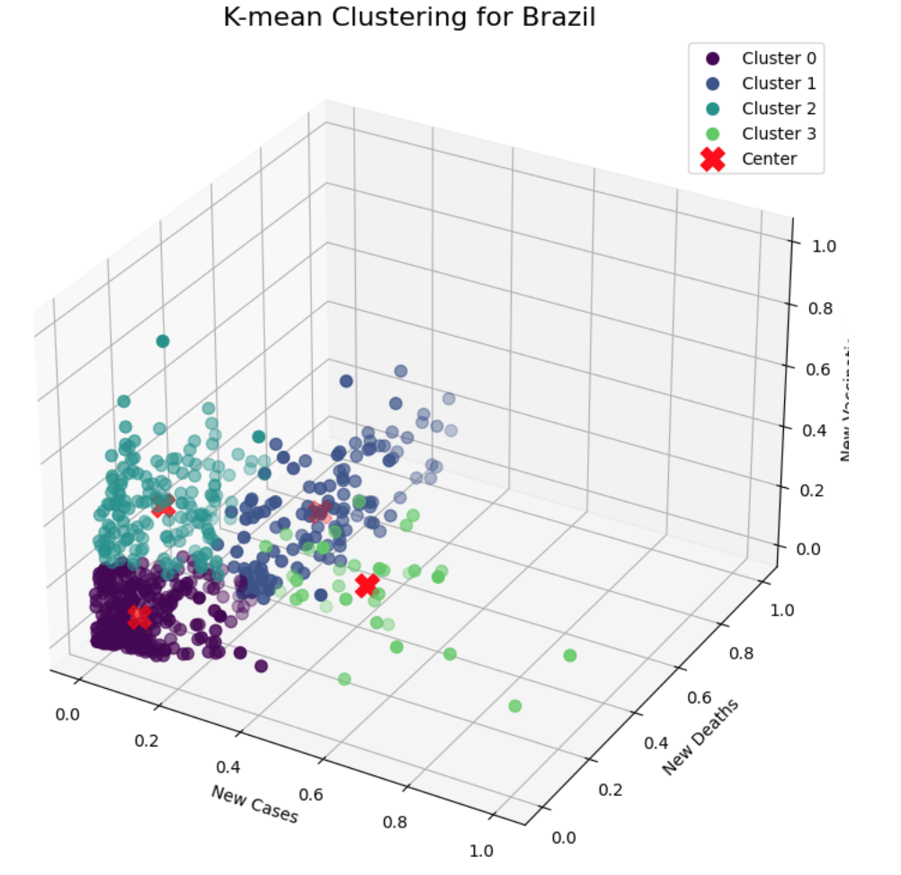
Clustering: K mean
3D plot for k mean clustering (United States, India and Brazil)

Slide 13
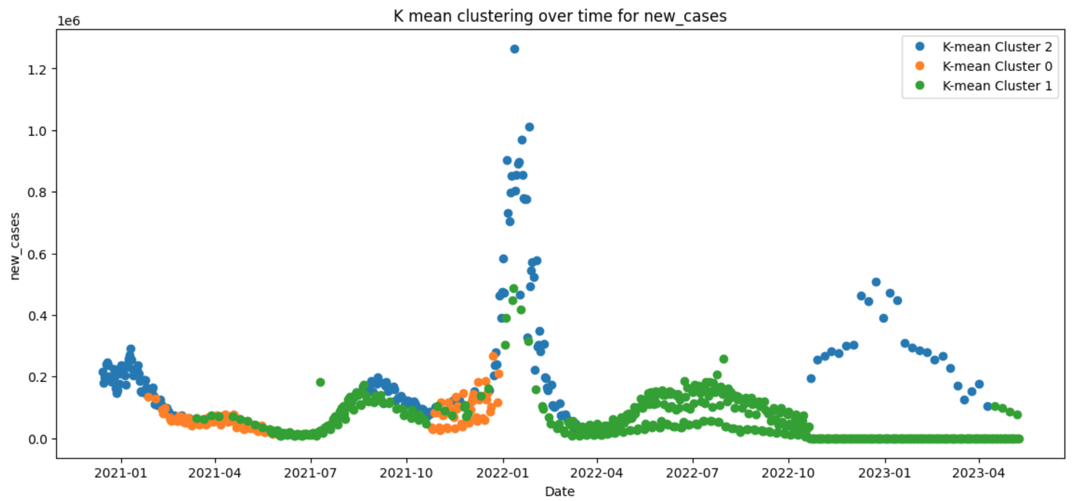
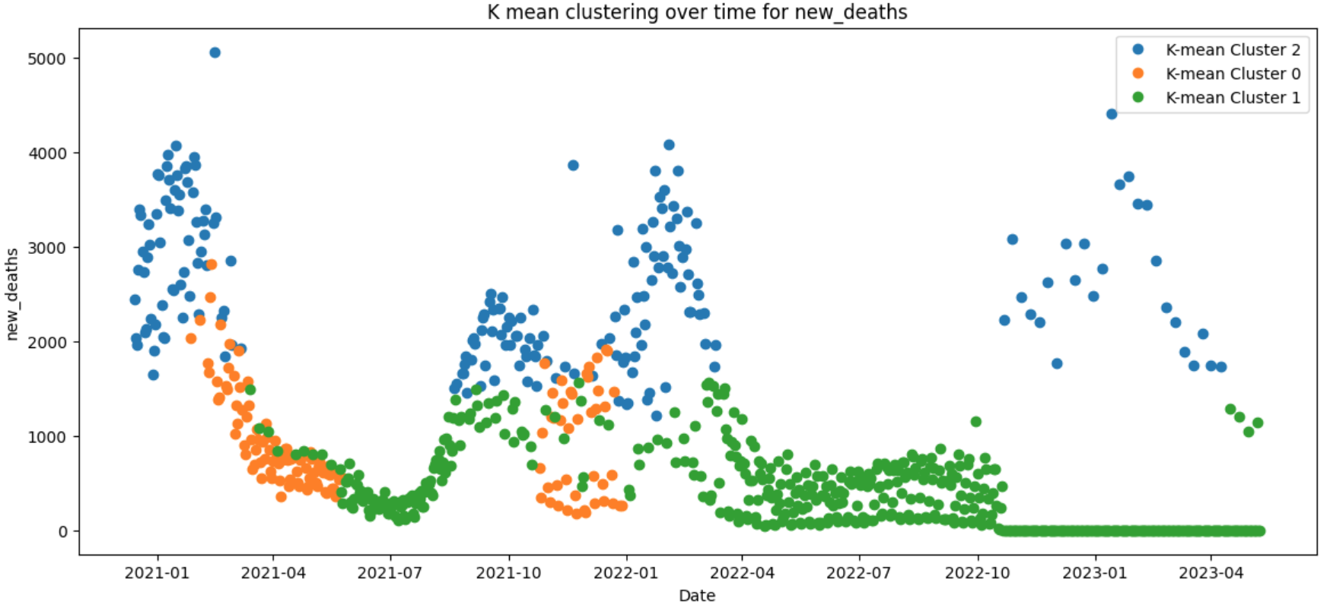

Slide 14
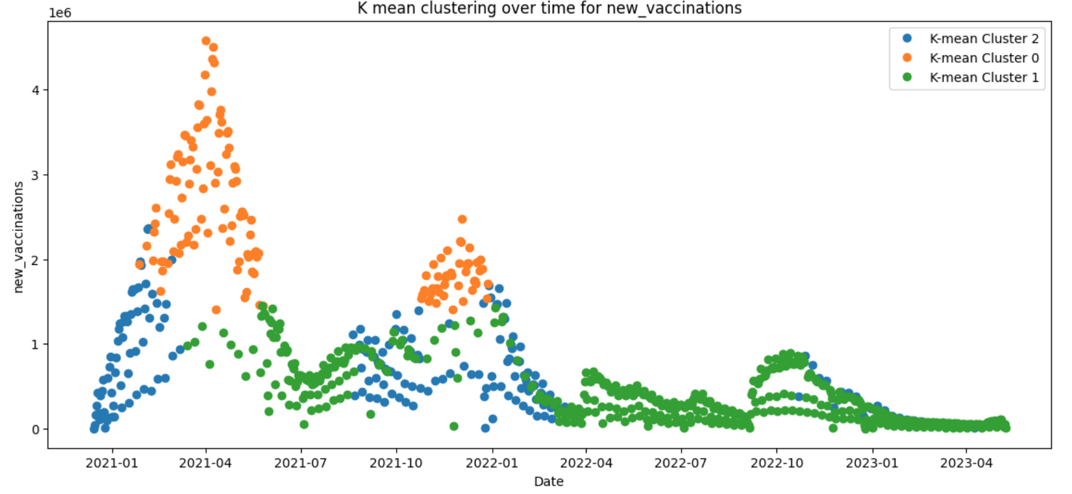
Time series clustered data for new vaccination, death and cases on United States

Slide 15
Interpretation for K mean Clustering
Cluster Metrics | Cluster | Size | Range of Date | Stringency
Number of Clusters: 3 SS: 0.556 DBS: 0.768 CHS: 886.394 | 0 1 2 | 131 549 196 | 2021-01-27 to 2021-12-28 2021-03-14 to 2023-05-09 2020-12-14 to 2023-04-09 | 48.44 to 71.76 24.09 to 64.35 24.09 to 71.76
Summary | Cluster 2 has the highest average new cases. Cluster 2 has the highest average new deaths. Cluster 0 has the highest average new_vaccinations.
Table: Interpretation for K mean for country United States
Cluster Metrics | Cluster | Size | Range of Date | Stringency
Number of Clusters: 2 SS: 0.726 DBS: 0.744 CHS: 939.717 | 0 1 | 899 90 | 2021-01-16 to 2023-11-21 2021-04-10 to 2022-03-26 | 28.70 to 81.94 43.06 to 81.94
Summary | Cluster 1 has the highest average new cases. Cluster 1 has the highest average new deaths. Cluster 1 has the highest average new_vaccinations.
Table: Interpretation for K mean for country India

Slide 16
Interpretation for K mean Clustering
Cluster Metrics | Cluster | Size | Range of Date | Stringency
Number of Clusters: 3 SS: 0.725 DBS: 0.649 CHS: 1528.656 | 0 1 2 | 180 707 38 | 2021-03-12 to 2022-01-28 2020-12-28 to 2023-07-10 2021-01-03 to 2022-04-24 | 36.34 to 75.0 11.11 to 75.0 18.82 to 75.0
Summary | Cluster 2 has the highest average new cases. Cluster 2 has the highest average new deaths. Cluster 0 has the highest average new_vaccinations.
Table: Interpretation for K mean for country France
Cluster Metrics | Cluster | Size | Range of Date | Stringency
Number of Clusters: 3 SS: 0.702 DBS: 0.701 CHS: 988.201 | 0 1 2 | 128 664 39 | 2021-04-07 to 2022-01-27 2020-12-28 to 2023-04-07 2021-01-03 to 2022-10-30 | 38.69 to 75.00 11.11 to 85.19 11.11 to 83.33
Summary | Cluster 2 has the highest average new cases. Cluster 2 has the highest average new deaths. Cluster 0 has the highest average new_vaccinations.
Table: Interpretation for K mean for country Germany

Slide 17
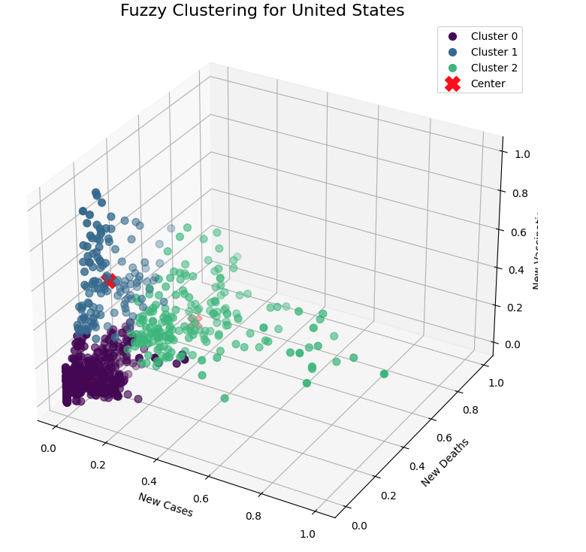
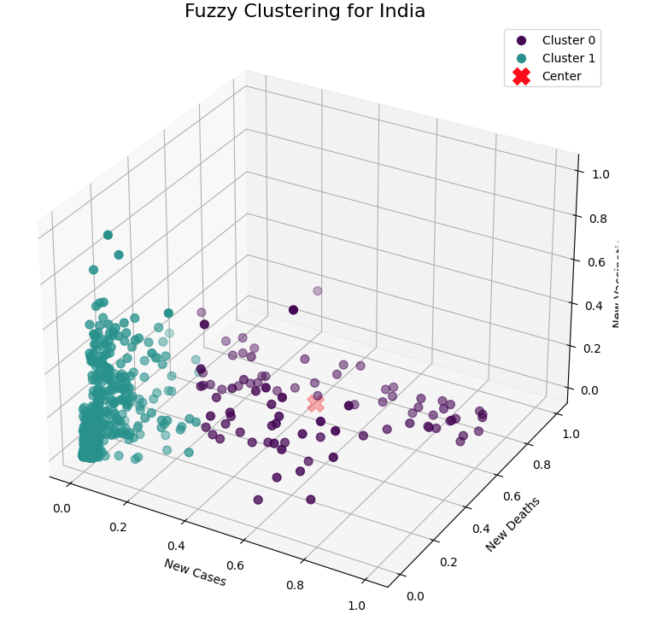
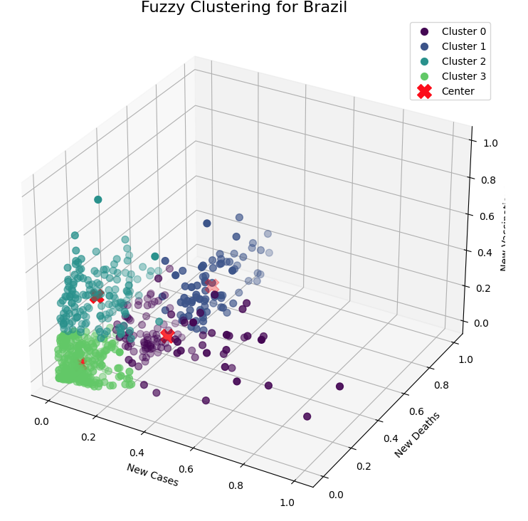
Clustering: Fuzzy
3D plot for Fuzzy mean clustering (United States, India and Brazil)

Slide 18
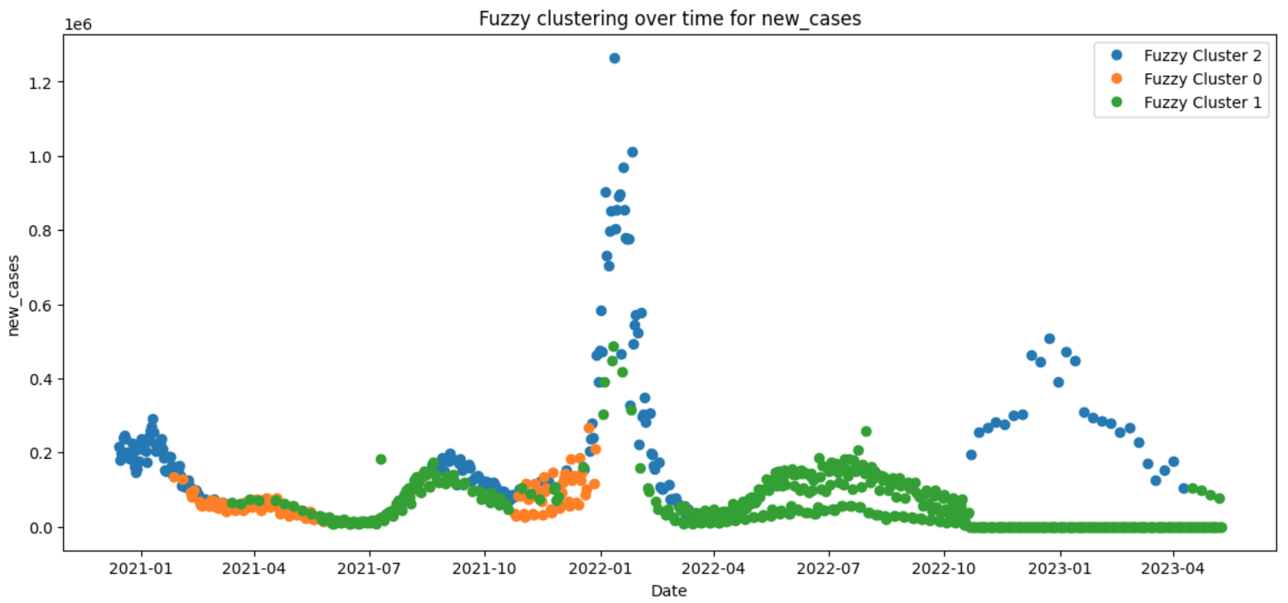
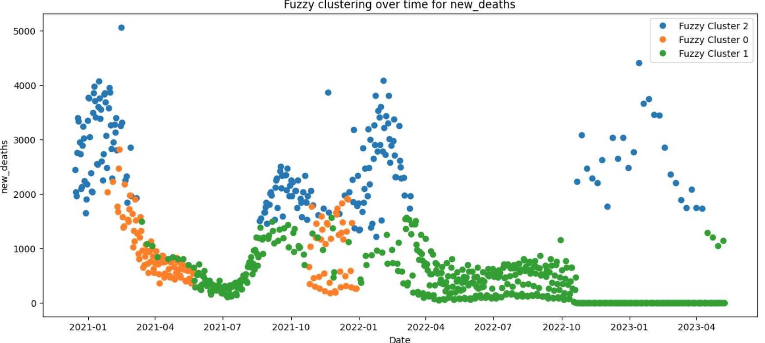

Slide 19
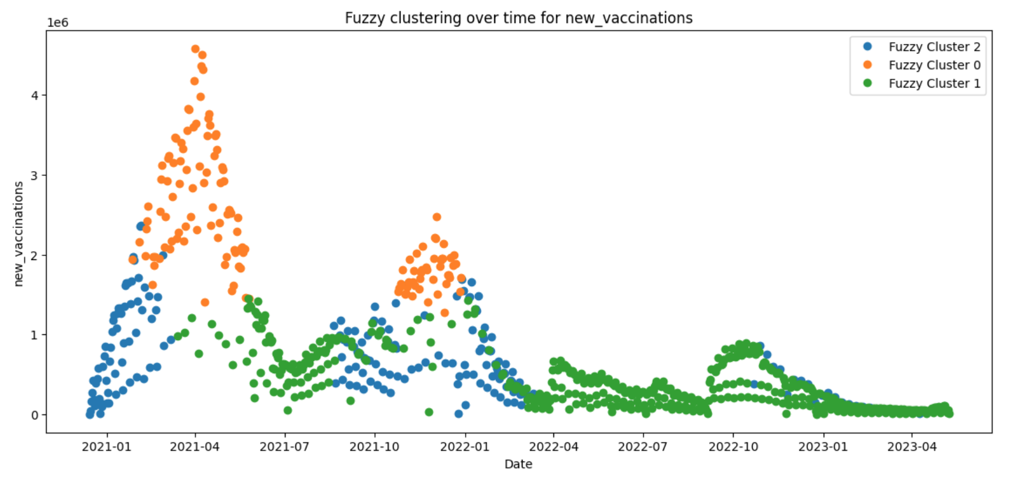
Time series clustered data for new vaccination, death and cases on United States

Slide 20
Interpretation for Fuzzy Clustering
Cluster Metrics | Cluster | Size | Range of Date | Stringency
Number of Clusters: 3 SS: 0.556 DBS: 0.770 CHS: 886.324 | 0 1 2 | 132 548 196 | 2021-01-27 to 2021-12-28 2021-03-14 to 2023-05-09 2020-12-14 to 2023-04-09 | 48.44 to 71.76 24.09 to 64.35 24.09 to 71.76
Summary | Cluster 2 has the highest average new cases. Cluster 2 has the highest average new deaths. Cluster 0 has the highest average new_vaccinations.
Table: Interpretation for Fuzzy for country United States
Cluster Metrics | Cluster | Size | Range of Date | Stringency
Number of Clusters: 2 SS: 0.726 DBS: 0.744 CHS: 939.717 | 0 1 | 90 899 | 2021-04-10 to 2022-03-26 2021-01-16 to 2023-11-21 | 43.06 to 81.94 28.70 to 81.94
Summary | Cluster 0 has the highest average new cases. Cluster 0 has the highest average new deaths. Cluster 0 has the highest average new_vaccinations.
Table: Interpretation for Fuzzy for country India

Slide 21
Interpretation for Fuzzy Clustering
Cluster Metrics | Cluster | Size | Range of Date | Stringency
Number of Clusters: 3 SS: 0.725 DBS: 0.649 CHS: 1528.656 | 0 1 2 | 38 180 707 | 2021-01-03 to 2022-04-24 2021-03-12 to 2022-01-28 2020-12-28 to 2023-07-10 | 18.82 to 75.0 36.34 to 75.0 11.11 to 75.0
Summary | Cluster 0 has the highest average new cases. Cluster 0 has the highest average new deaths. Cluster 1 has the highest average new_vaccinations.
Table: Interpretation for Fuzzy for country France
Cluster Metrics | Cluster | Size | Range of Date | Stringency
Number of Clusters: 3 SS: 0.466 DBS: 0.807 CHS: 583.533 | 0 1 2 | 192 89 550 | 2021-02-26 to 2022-03-03 2021-04-07 to 2022-01-20 2020-12-28 to 2023-04-07 | 28.33 to 81.48 42.29 to 75.00 11.11 to 85.19
Summary | Cluster 2 has the highest average new cases. Cluster 2 has the highest average new deaths. Cluster 1 has the highest average new_vaccinations..
Table: Interpretation for Fuzzy for country Germany

Slide 22
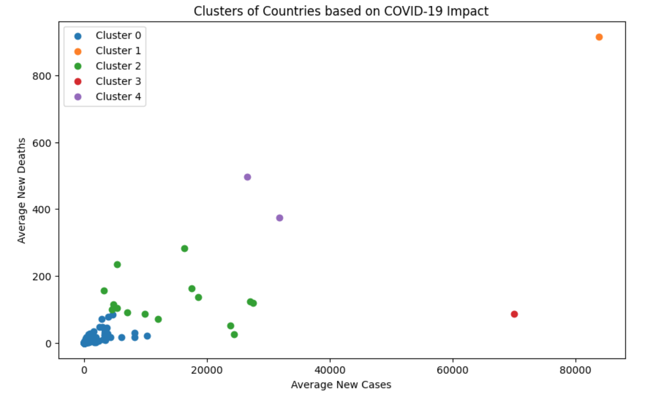
Compare all countries based on avg new cases and new deaths – K mean
Cluster 0 has 199 Countries
Cluster 1 has 1 Country
Cluster 2 has 15 Countries
Cluster 3 has 1 Country
Cluster 4 has 2 Countries

Slide 23
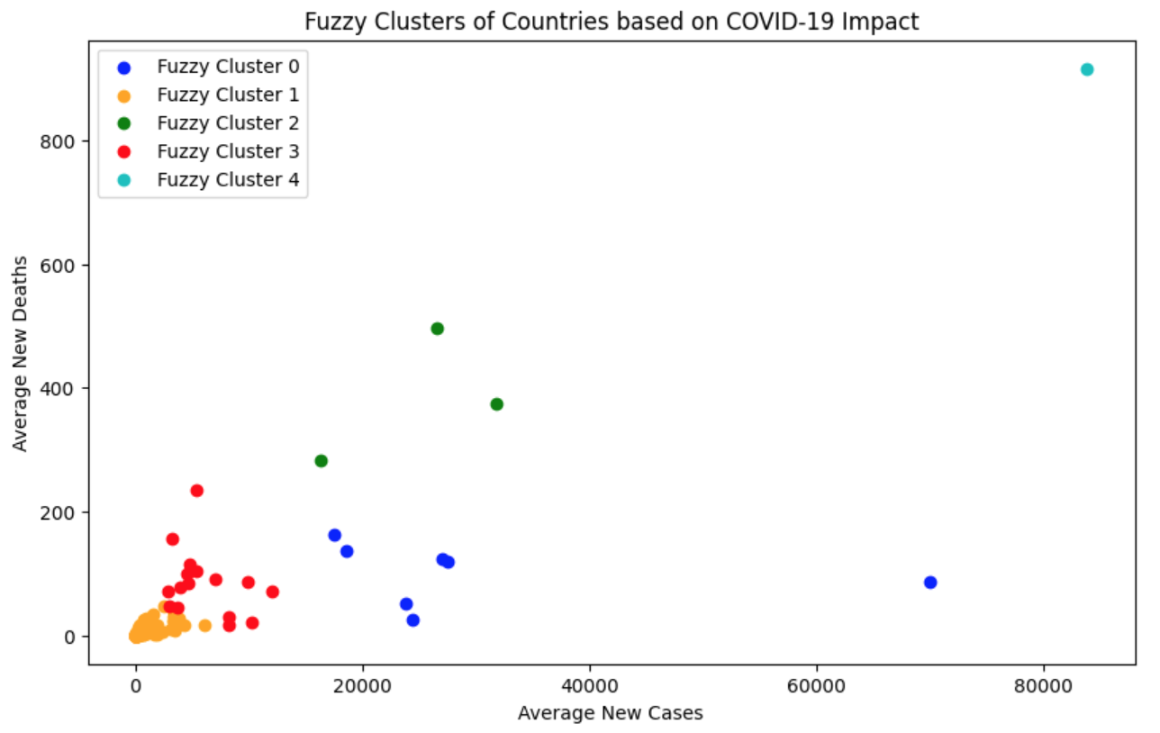
Compare all countries based on avg new cases and new deaths – Fuzzy
Cluster 0 has 16 Countries
Cluster 1 has 7 Countries
Cluster 2 has 3 Countries
Cluster 3 has 191 Countries
Cluster 4 has 1 Country

Slide 24
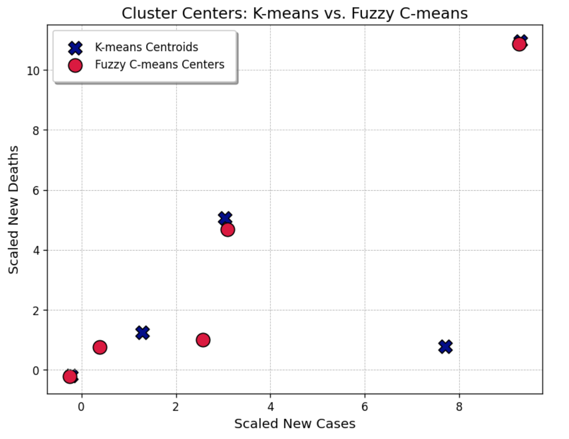
Compare all countries based on avg new cases and new deaths - Comparison
Comparison between cluster centers for K mean and fuzzy Clustering

Slide 25
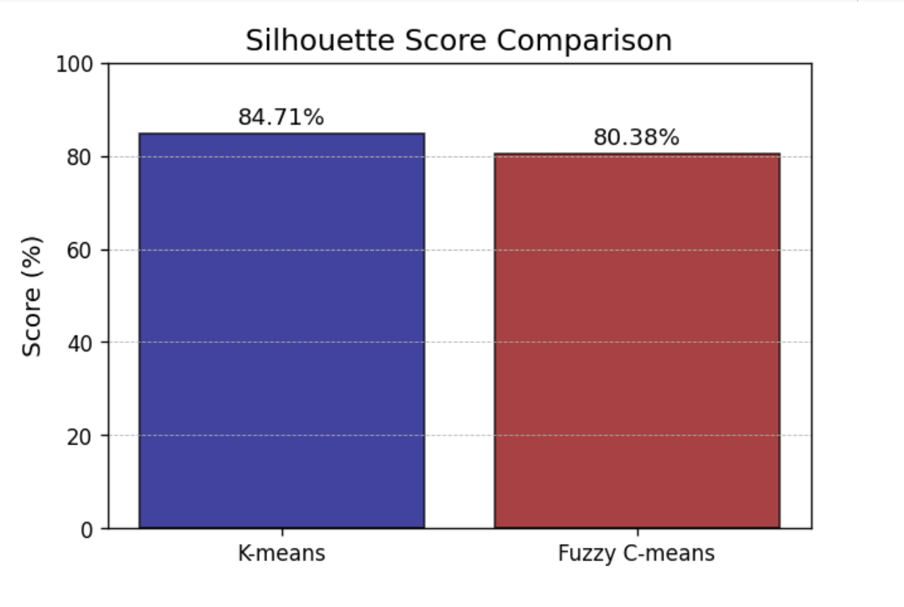
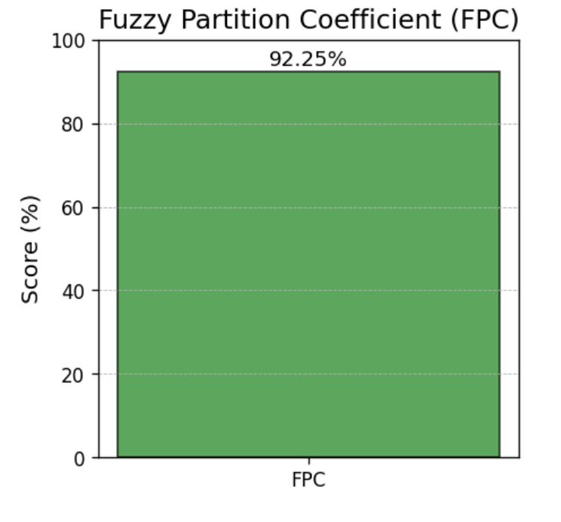
Compare all countries based on avg new cases and new deaths- Performance

Slide 26
Conclusion
Clear patterns and trends in COVID-19 data were identified using both K-means and Fuzzy Clustering techniques.
Implications for Public Health Decision-Making
Limitation of the Study.
Future Research:
Explore hybrid clustering methods
Add additional data sources and variables.
Outlier detection and removal impact in Cluster analysis for COVID-19 data

Slide 27

Thank You

